Slide 1
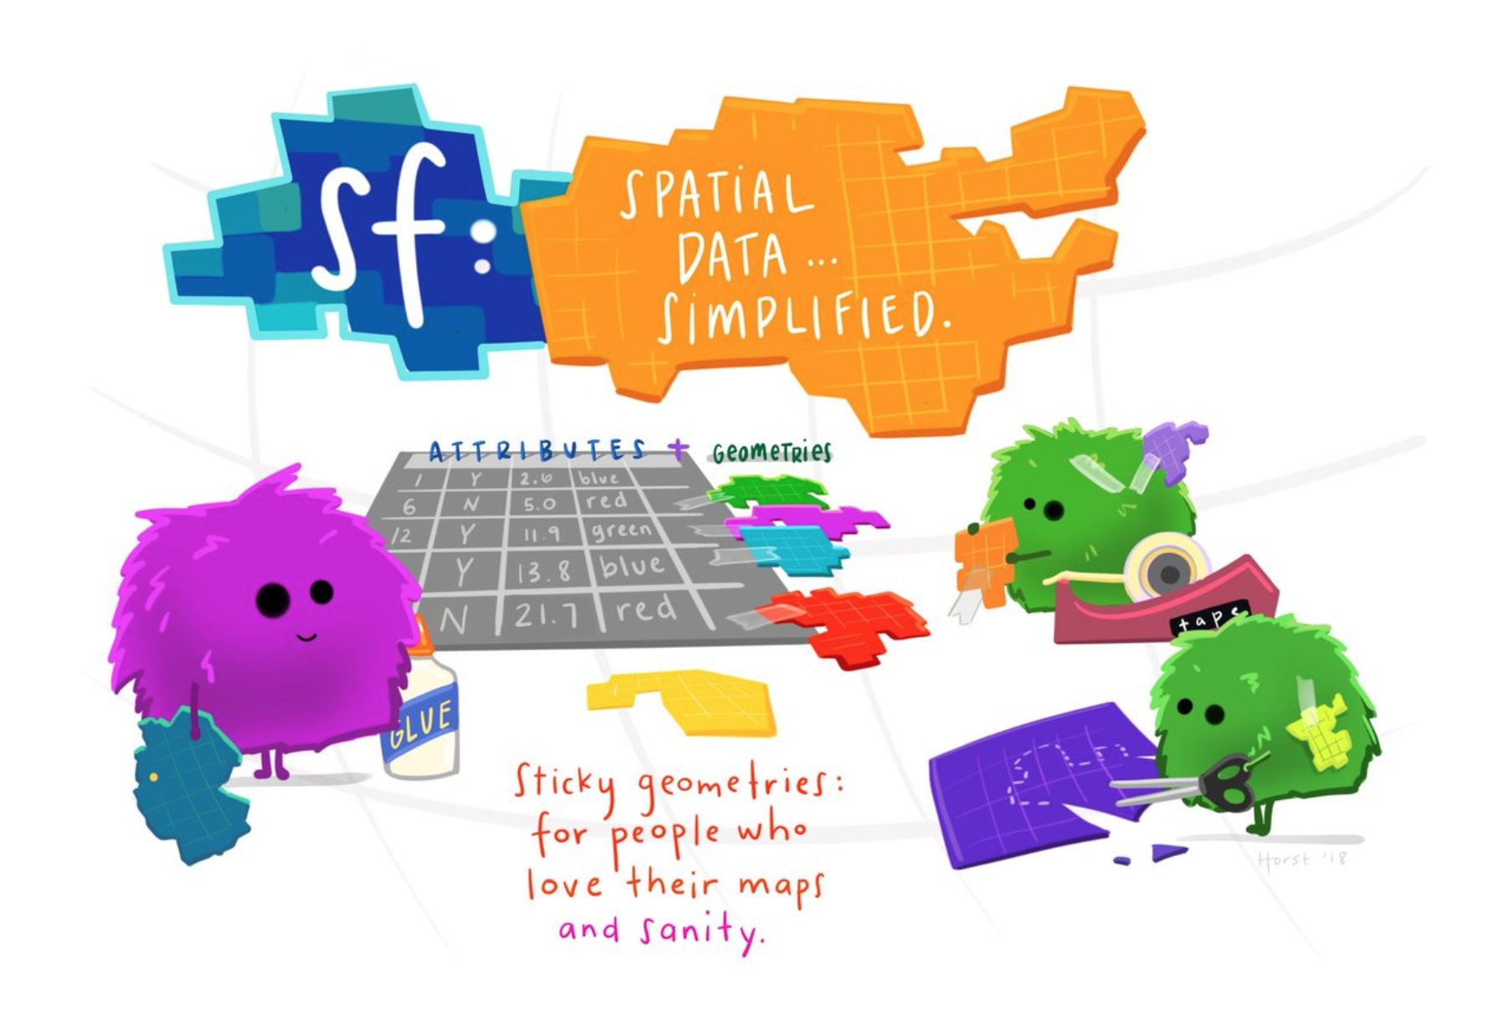
A Continuation of Mapping with the sf, leaflet, and marmap packages
Natalya Gallo
R-Users Meeting May 6, 2020

Slide 2
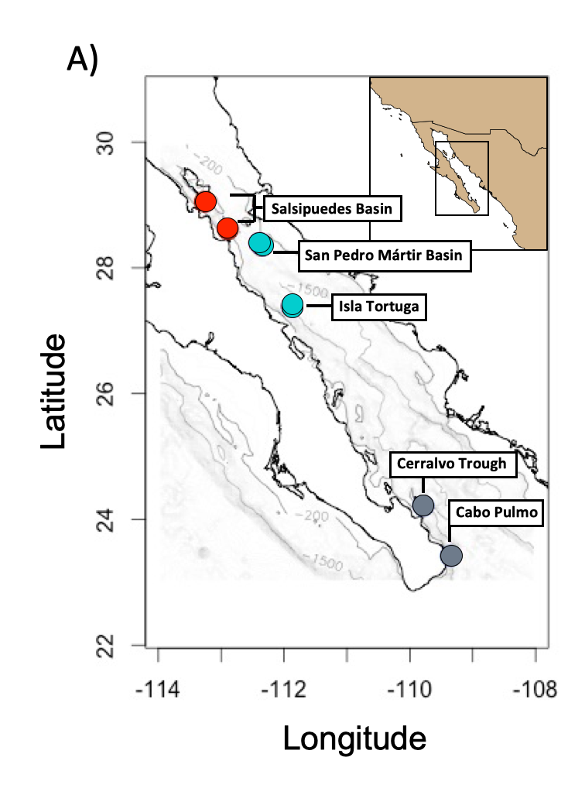
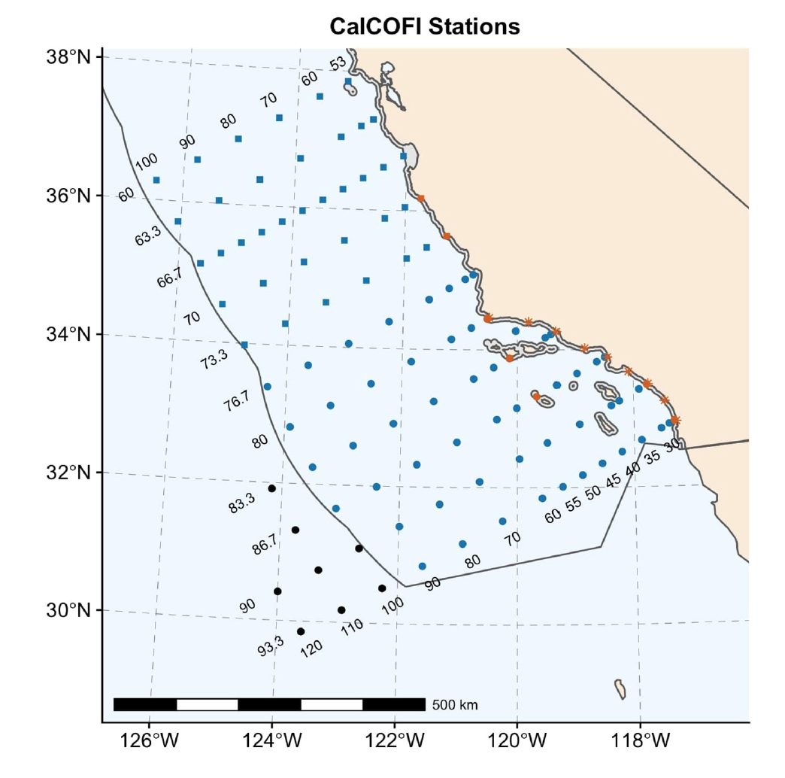
My Venture Into Mapping with the sf package
Gallo et al. (2020) MEPS
Gallo et al. (2019) FMS

Slide 3
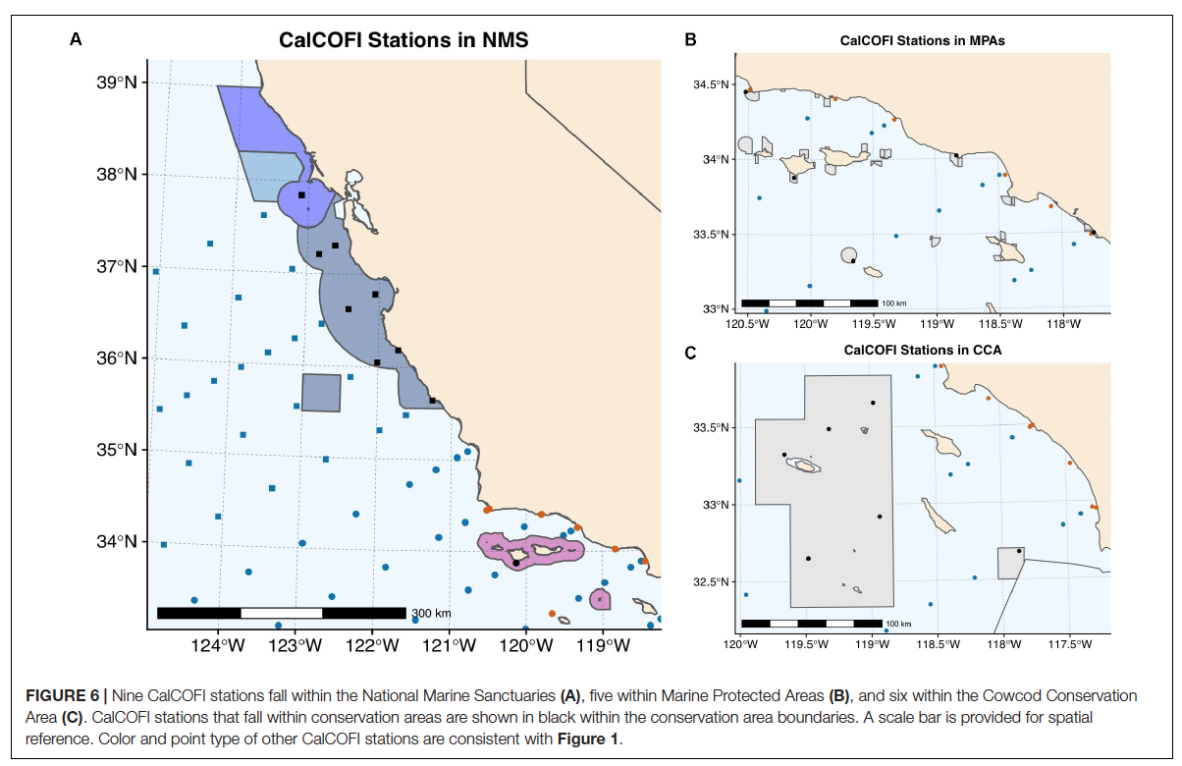
How many and which CalCOFI stations fall within US West Coast conservation areas?
Gallo et al. (2019) FMS

Slide 4
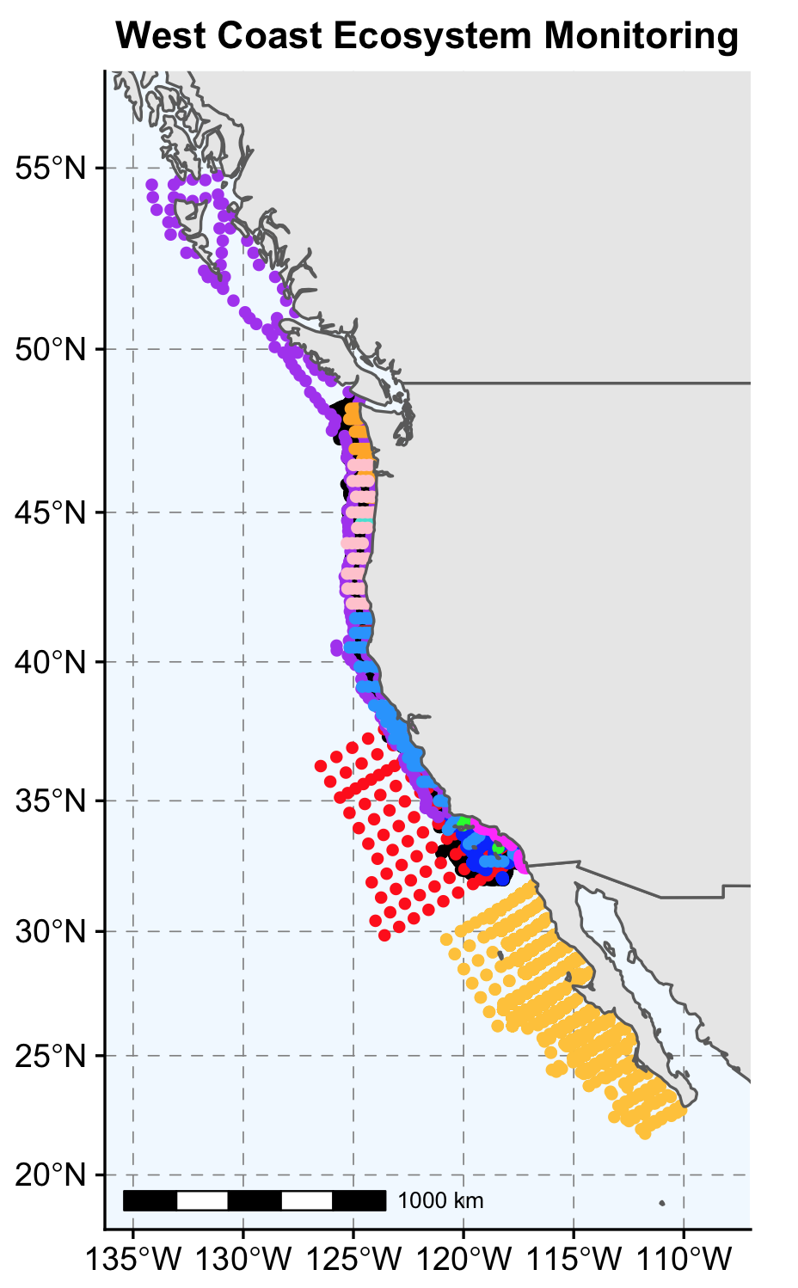
Next steps: Add sites of other monitoring programs
Gallo et al. work in progress

Slide 5
Goals for today:
Make a map of CalCOFI stations and look at how they overlap with marine jurisdictions and marine conservation areas (using the sf package)
Make an interactive map of all historic CalCOFI stations and colorcode by sampling frequency (using the leaflet package)
Add bathymetry and coastline data (using the marmap package) (pretty sure we won’t get to this)

Slide 6
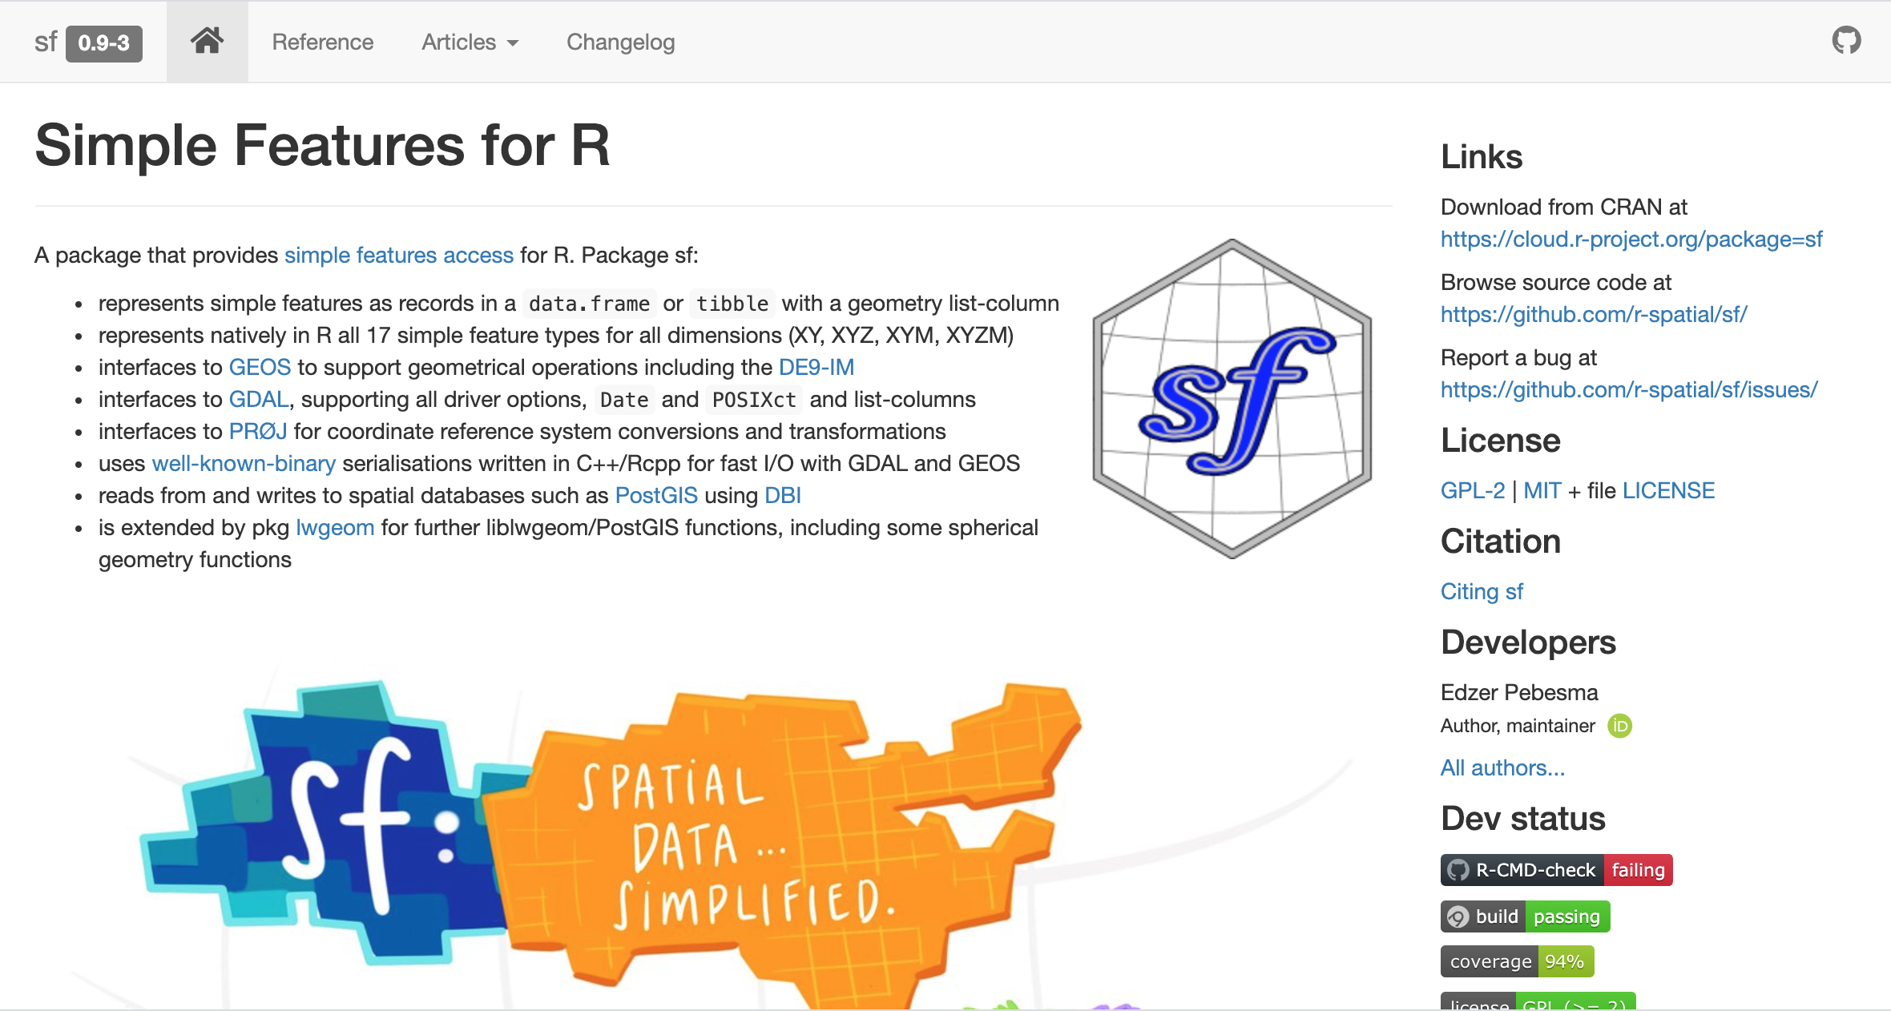

Slide 7
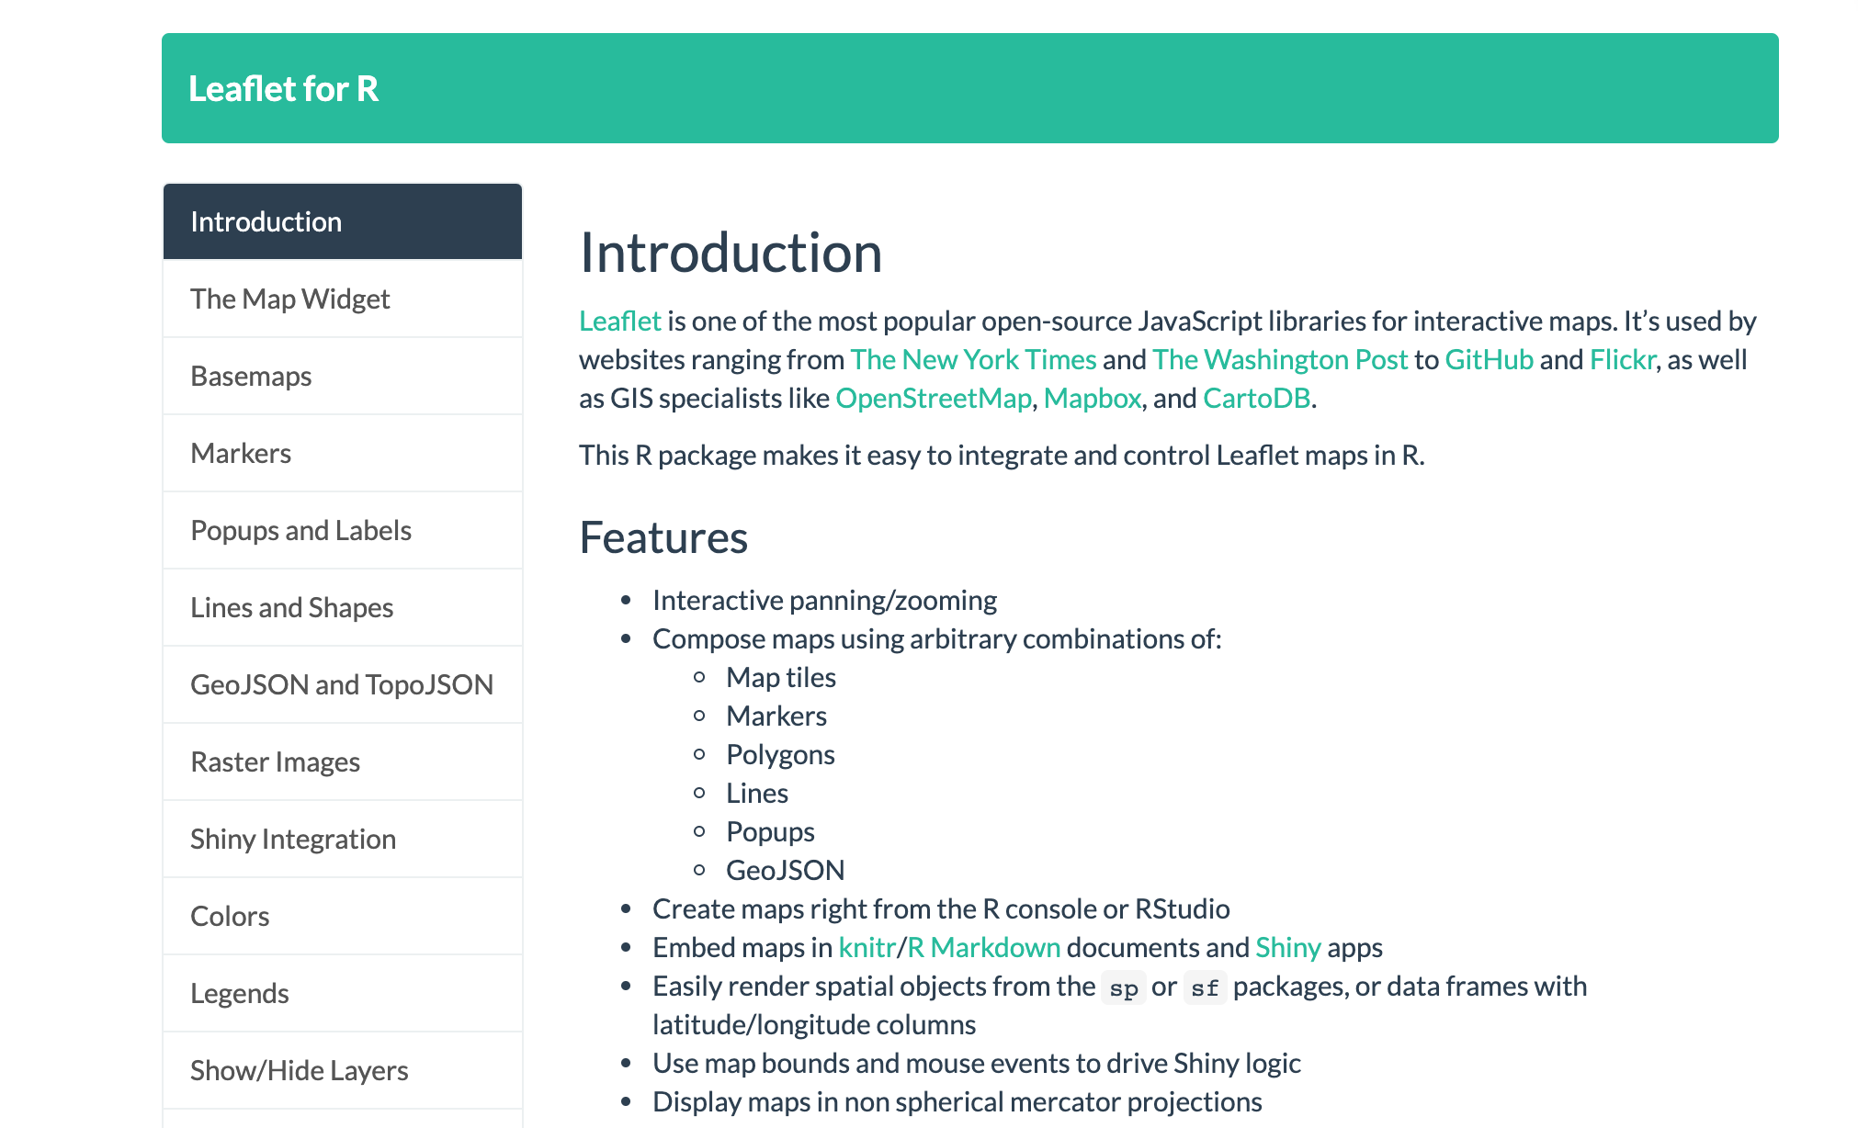

Slide 8
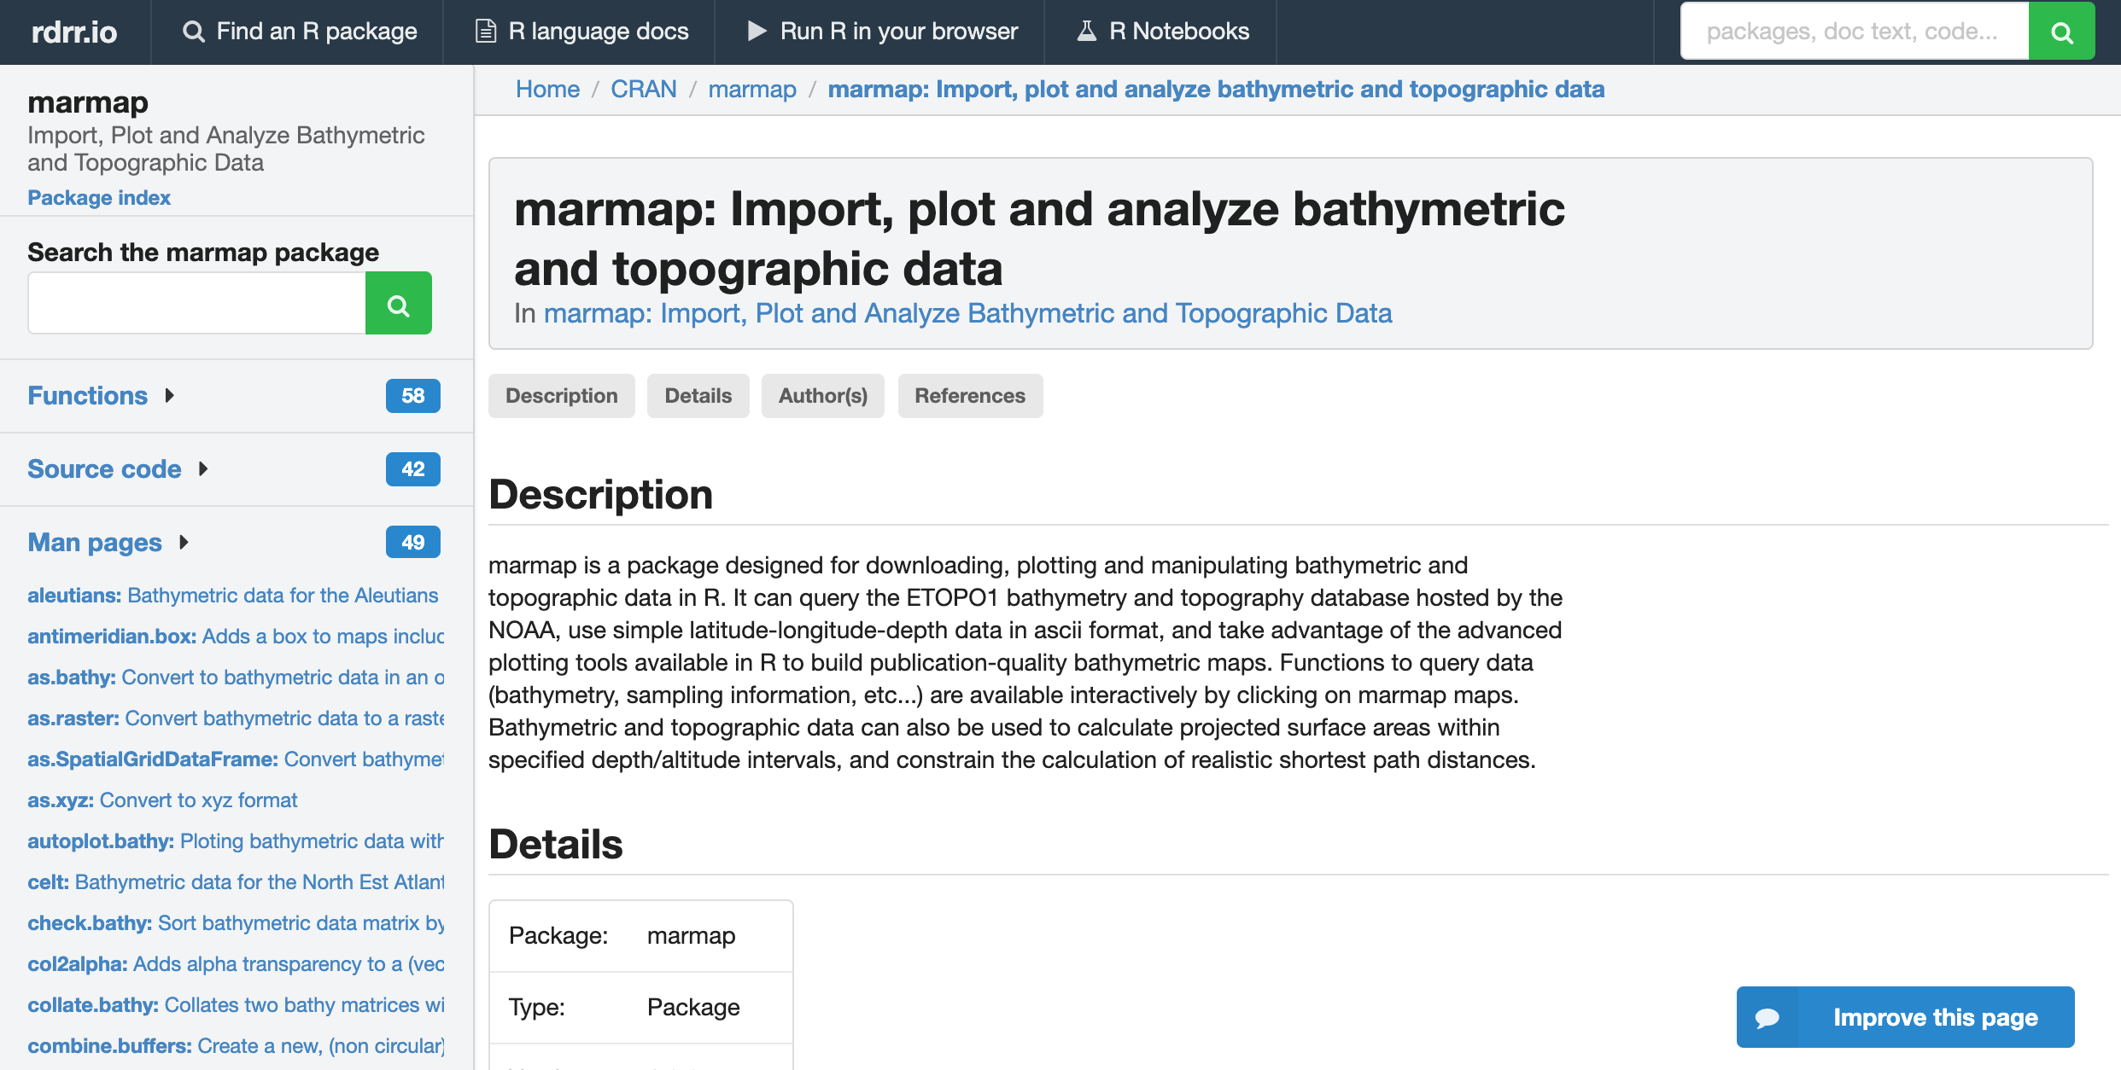

Slide 9
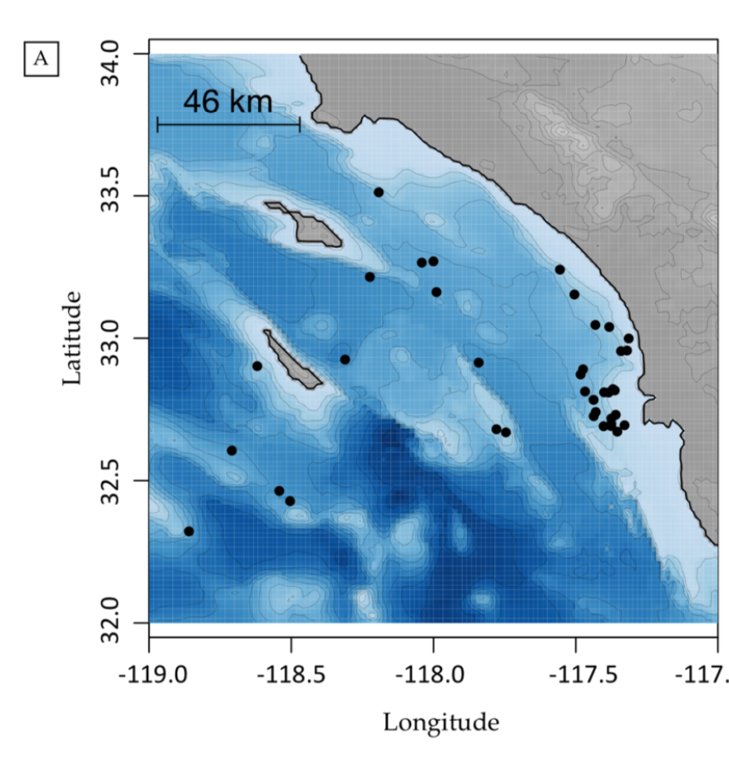
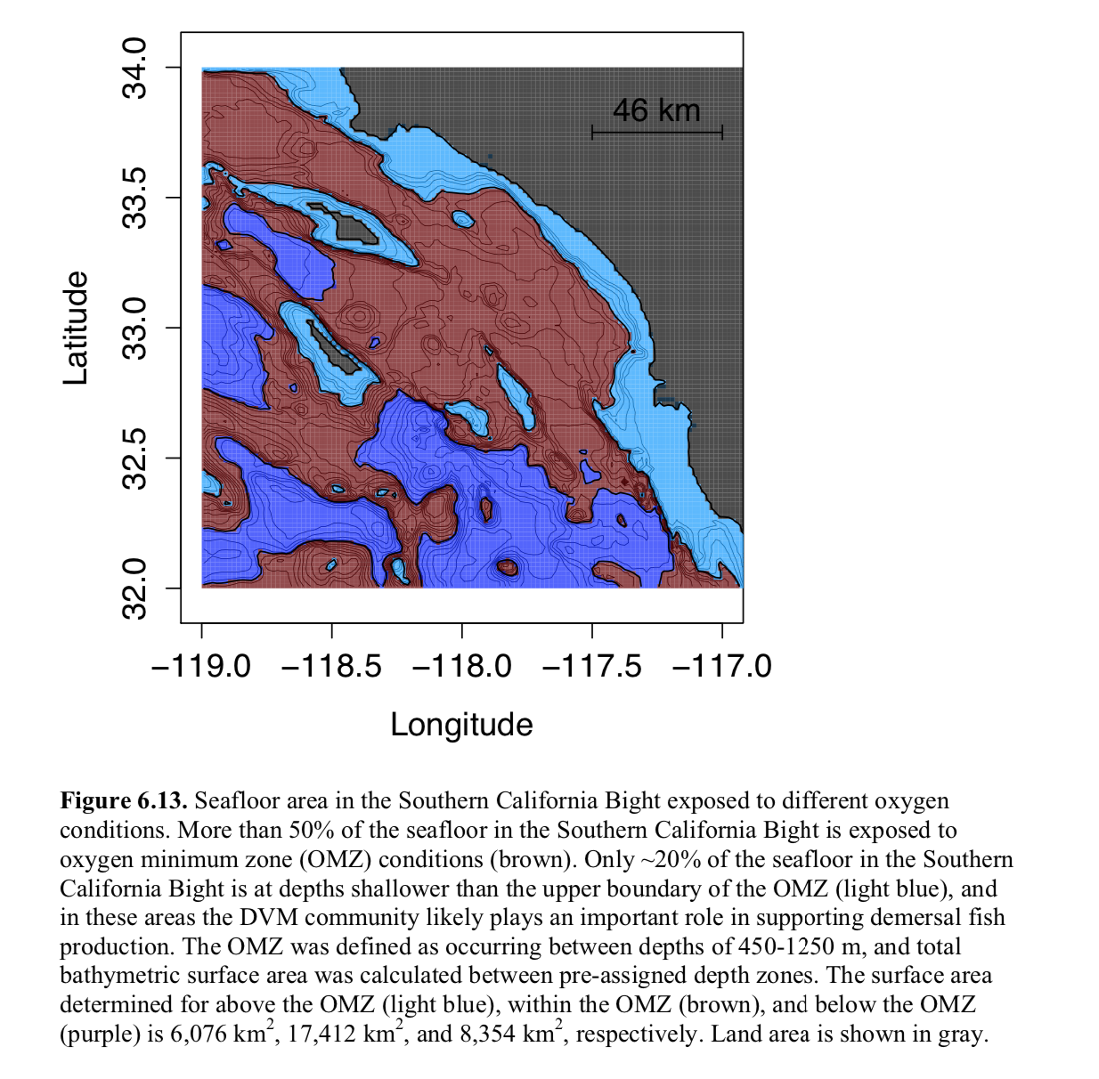
Gallo (2018)

Slide 10
Helpful Resources:
#GIS in R
https://www.jessesadler.com/post/gis-with-r-intro/
https://www.jessesadler.com/post/simple-feature-objects/
https://www.r-spatial.org//r/2018/10/25/ggplot2-sf.html
#sf package
https://r-spatial.github.io/sf/
sf cheatsheet: https://github.com/rstudio/cheatsheets/blob/master/sf.pdf
#1-Day Data Wrangling and Spatial Analysis R Course
http://www.seascapemodels.org/rstats/2019/02/23/new-r-course-posted-online.html
#Leaflet for interactive maps
https://rstudio.github.io/leaflet/
http://leaflet-extras.github.io/leaflet-providers/preview/index.html
#Importing bathymetry and coastline data
https://www.r-bloggers.com/importing-bathymetry-and-coastline-data-in-r
#marmap package: awesome package for plotting bathymetric data https://www.molecularecologist.com/2015/07/marmap/ http://journals.plos.org/plosone/article?id=10.1371/journal.pone.0073051 (check out the Supplementary code) https://cran.r-project.org/web/packages/marmap/vignettes/marmap.pdf

